Slide 1



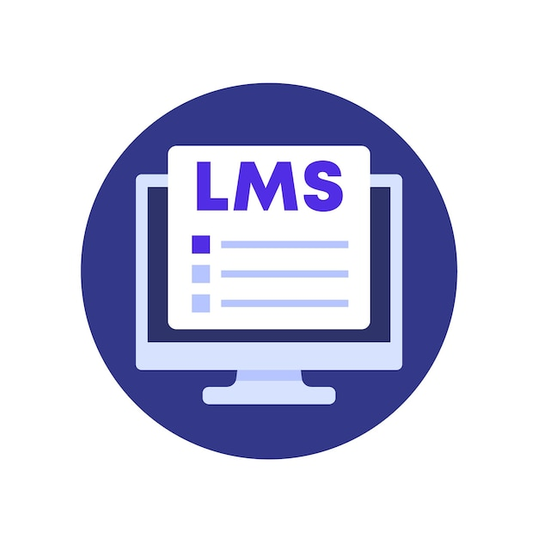







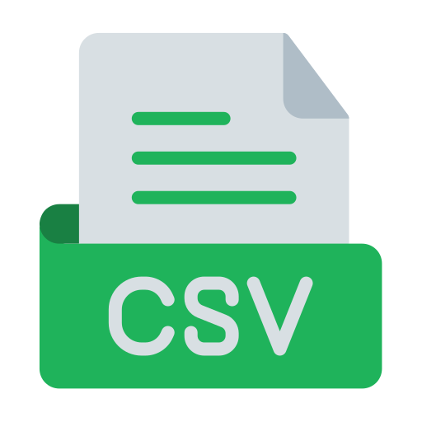
Project Architecture – LMS
One Lake
CI/CD
LMS
Fabric Pipeline
ADLS Gen-2
Lakehouse
Lakehouse
Lakehouse
Azure DevOps
+
Bronze
Silver
Gold
Medallion Architecture
Fabric Deployment Pipeline

